Slide 1
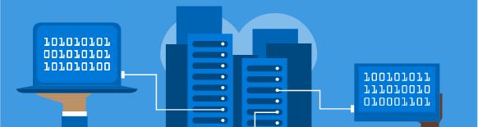
#jaxcloud @jaxcloudug #gab2017 April 22, 2017
Managing Your Azure Environment

Slide 2

Notes:
At Modis, we use our insight, knowledge and global resources to make exceptional connections every day. With 70 branch offices located strategically throughout North America, we are positioned perfectly to deliver the industry's top talent to each of our clients. Clients choose Modis as their workforce partner to solve staffing challenges that range from locating hard-to-find niche talent to completing quick-fill demands.

Slide 3

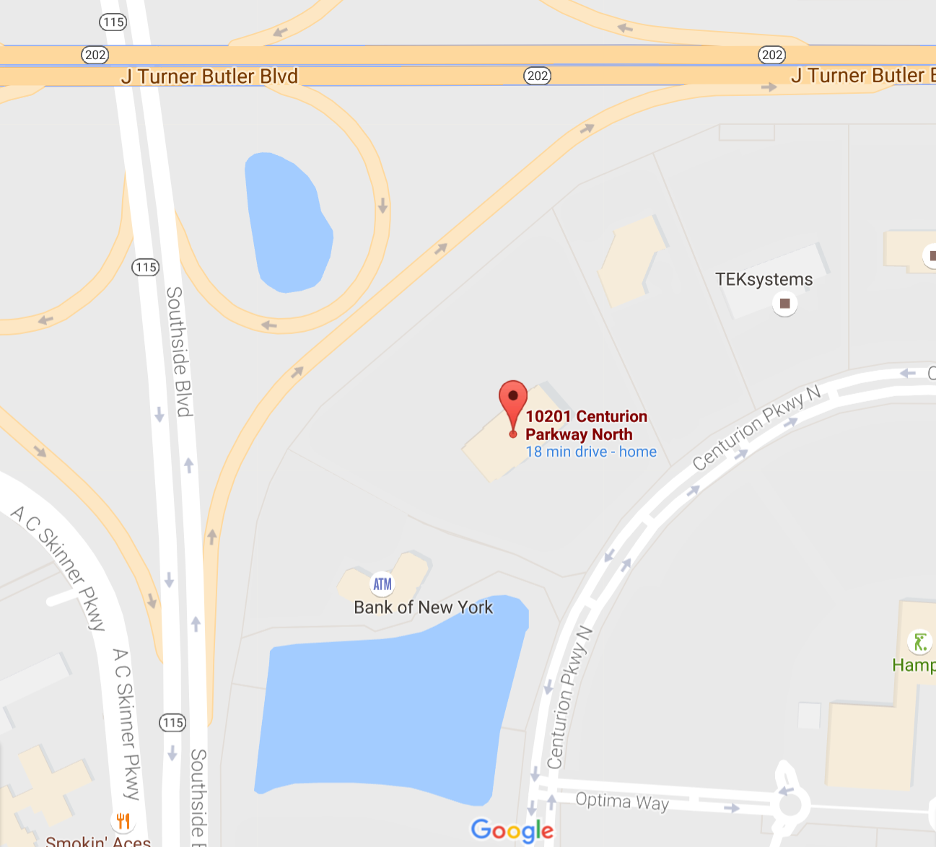

Logistics
Meeting time
4:30PM – 6:00PM
Location
Modis
10201 Centurion Pkwy
Jacksonville, FL
Next meetup Sept 22!

Slide 4

Join us on slack jaxcloudug.azurewebsites.net

Slide 5
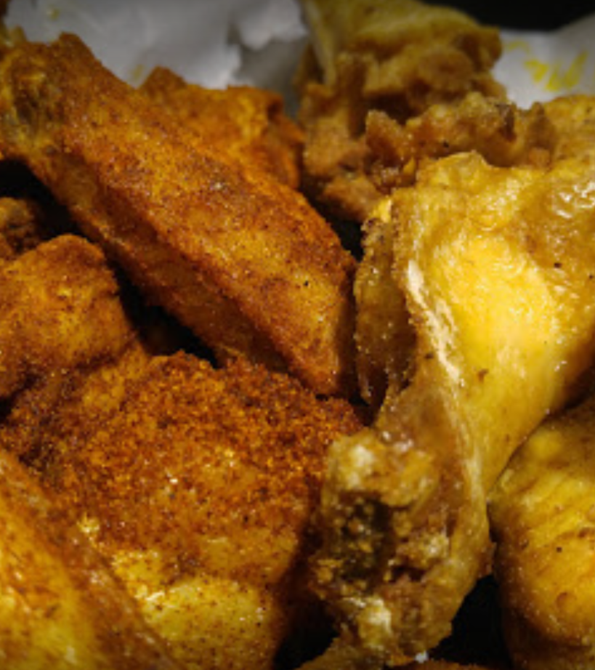
Meetup after at BW3s The Avenues, 10300 Southside Blvd, Jacksonville, FL 32256

Slide 6

#jaxcloud @jaxcloudug
http://jaxug.cloud https://jaxcloudug.azurewebsites.net

